Slide 1
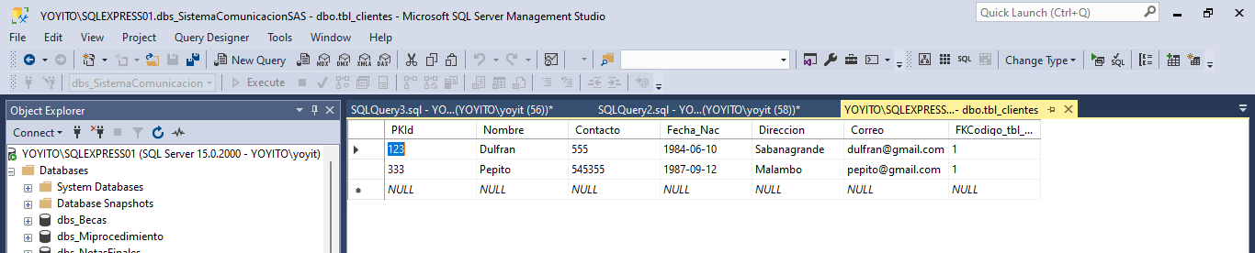
Insert
Update
Delete
Select

